Slide 1


Science of Addiction
Keaton PETERSON
student

Slide 2
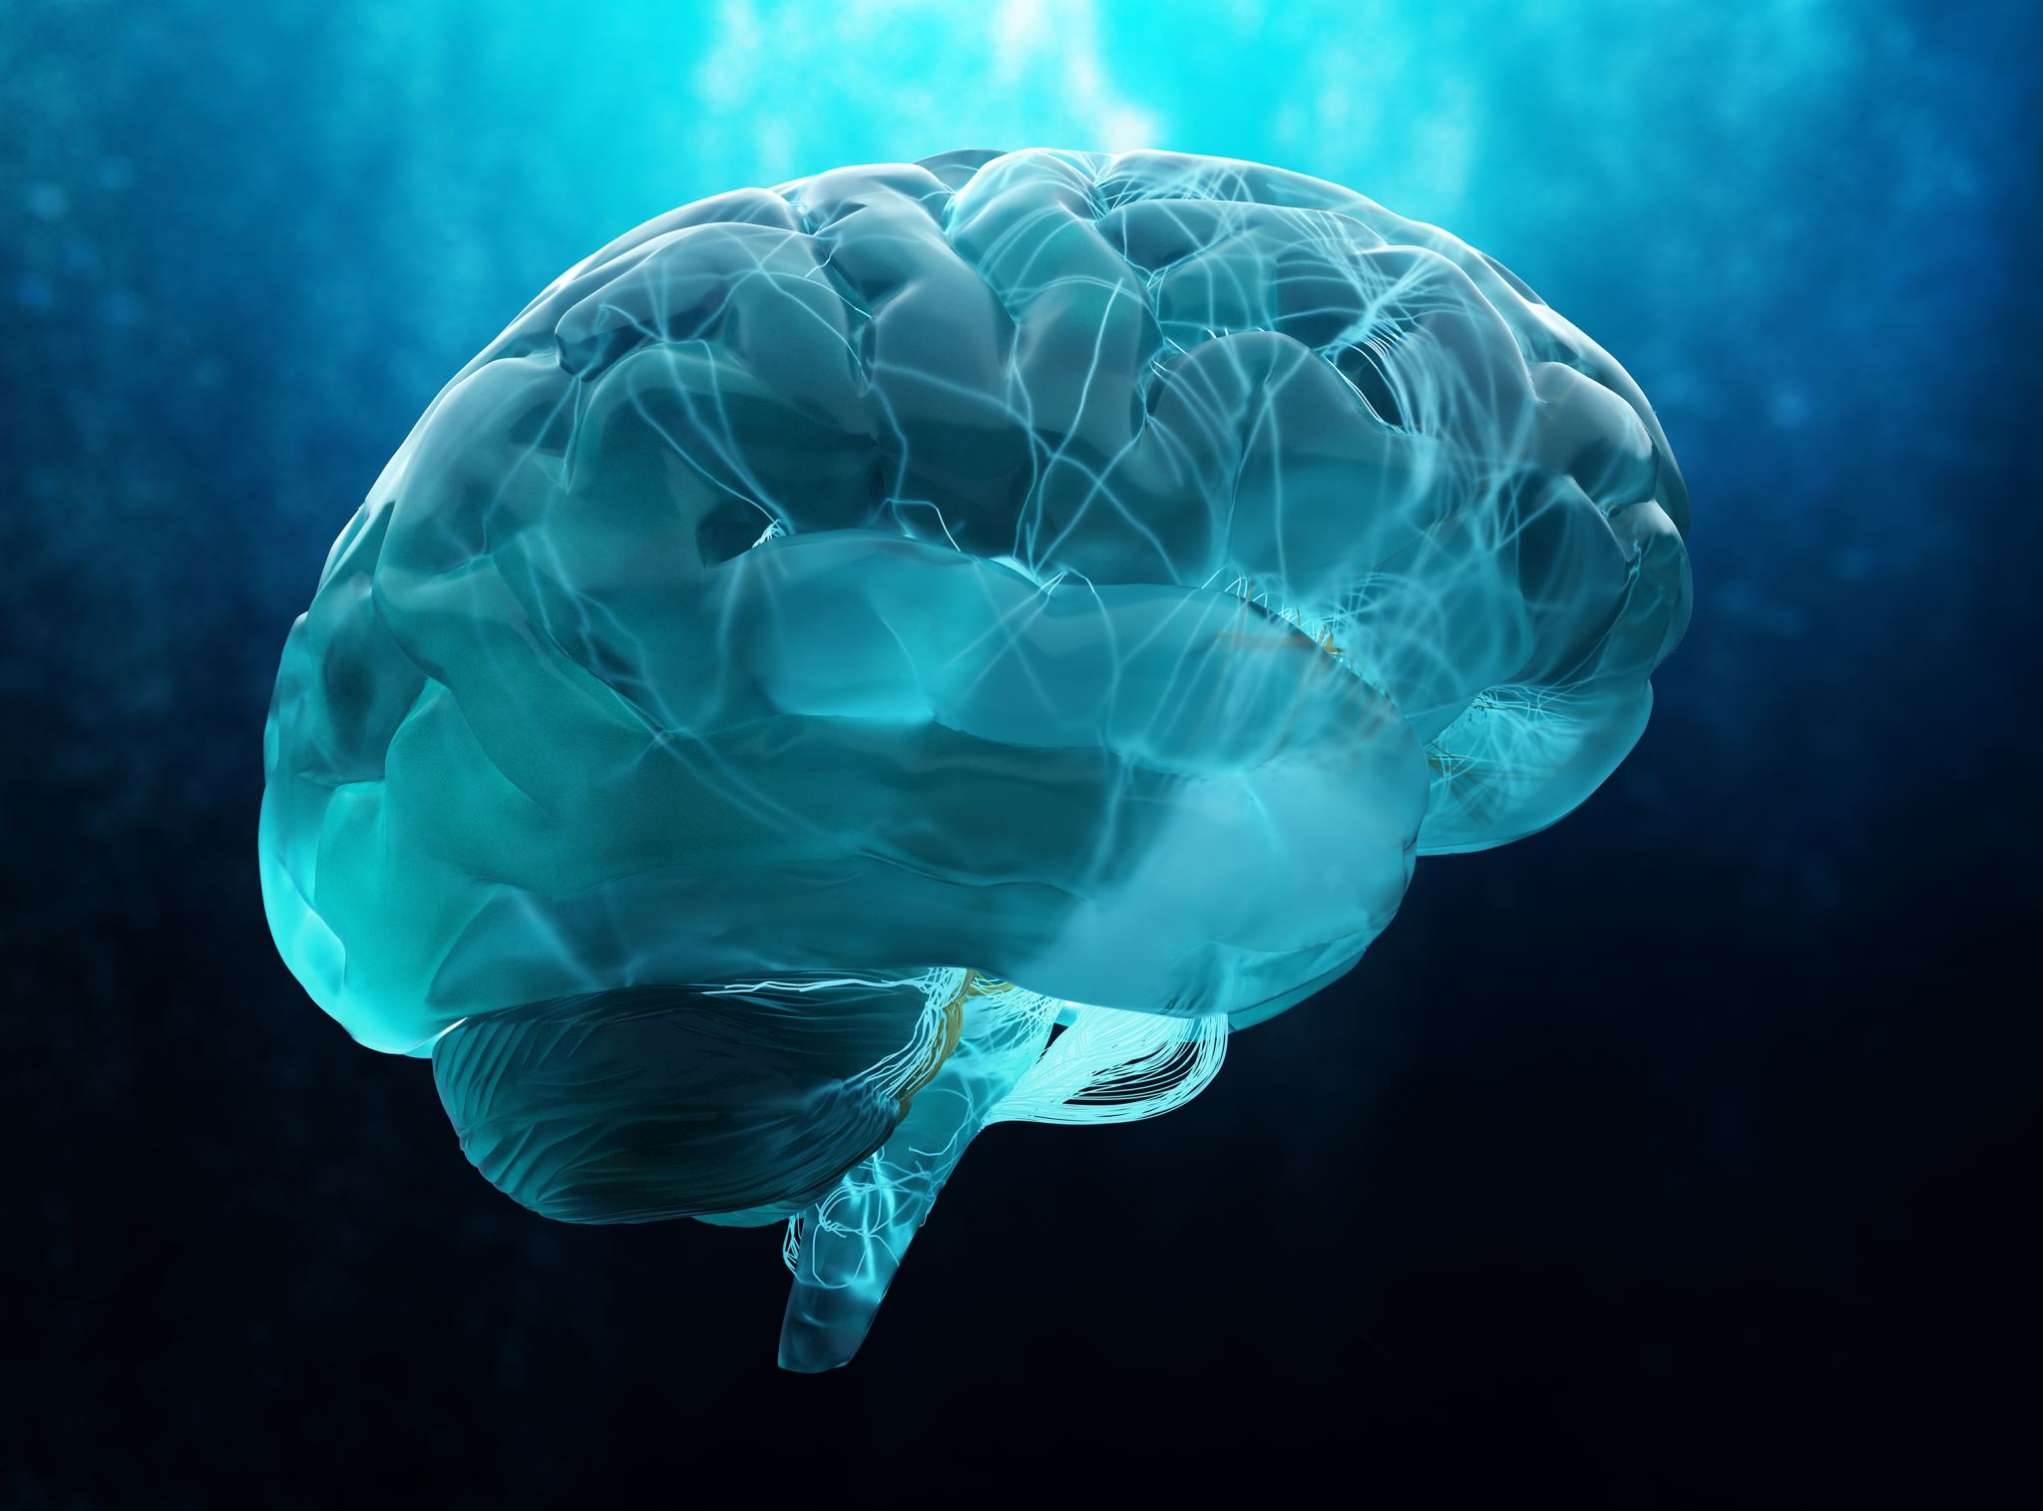
Introduction
Addiction is a chronic brain disease that changes how people think, feel, and make decisions.
It develops when substances affect the brain’s reward system, making control difficult despite harm.
Addiction impacts not only the individual but also families and relationships.
Understanding causes, withdrawal, and treatment helps with recognizing addiction and supporting recovery.

Slide 3
2024 Substance Use Data/Statistics
58.3% of people age 12 or older used alcohol, tobacco, vaping, or illicit drugs in the past month, and 46.6% reported drinking alcohol.
Among those who drink alcohol, 43.1% were binge drinkers.
16.8% of people (about 48.4 million) had a substance use disorder, including 9.8% with a drug use disorder.
In Nevada, 1,392 people died from drug overdoses in 2024

Slide 4
Key Statistics on Families Affected by Addiction​
Nearly 1 in 4 U.S. children (about 19 million) live with at least one parent who has a substance use disorder (SUD) — representing roughly 25 % of all children under 18.​
More than 6 million children live with a parent who has both an SUD and a co‑occurring mental illness. ​
Alcohol use disorder is the most common parental SUD, affecting over 12 million children, while cannabis and prescription drug disorders affect millions more. ​
Surveys indicate that around 25 % of adults report having an immediate family member with an addiction, and more than half of U.S. adults know a close relative with substance misuse issues.

Slide 5
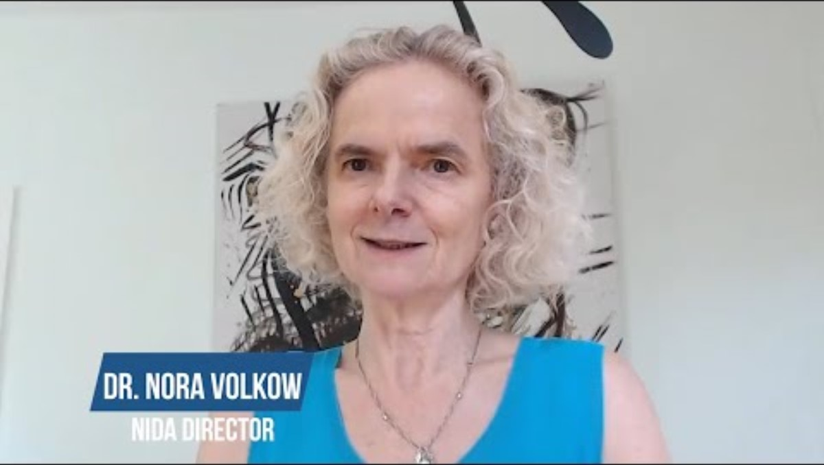
Key Points From the Video "Inside The Addicted Human Brain" By: Nora Valkow
Brain imaging shows that chronic substance use changes the structure and activity of key brain areas like the prefrontal cortex and nucleus accumbens
The prefrontal cortex, which controls decision-making and self-control, becomes impaired, making it harder to resist compulsive drug use.
Environmental cues linked to past drug use can trigger strong cravings by activating memory and motivation circuits, increasing the risk of relapse.
These neurological changes show that addiction is a chronic brain disorder that affects behavior, emotions, and impulse control.

Slide 6
Brain scans also reveal reduced activity in frontal brain circuits, which is linked to poor regulation of impulses and decisions.
Over time, addiction weakens the brain’s ability to manage stress, emotions, and self-control effectively.
Treatment is most effective when it addresses these brain changes and helps restore healthy brain function.
Understanding how addiction affects the brain improves prevention strategies and supports long-term recovery.
NIDA. (2018). Dr. Volkow explains the basics of drugs & addiction [Video]​

Slide 7
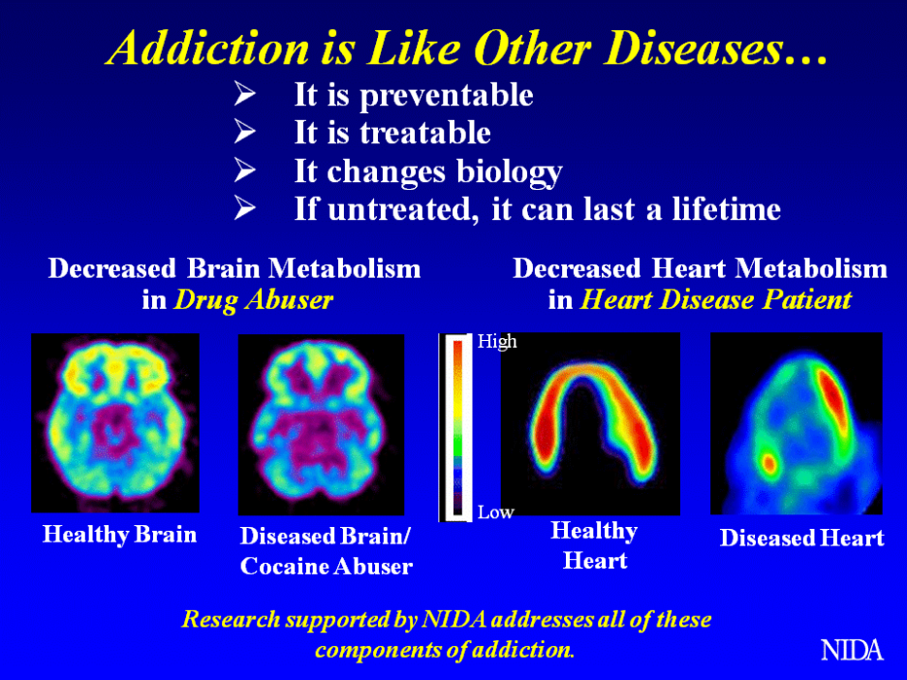

Slide 8
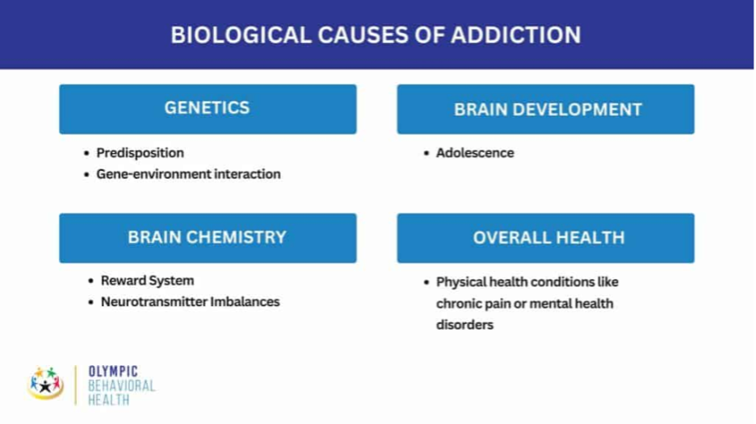
Dr. Volkow’s Message
Addiction is not a choice, but a condition in which a person loses control over intense drug cravings, often influenced by genetic risk, family history, or stressful environments.
Substance misuse refers to using drugs improperly, while addiction is the progression to compulsive use despite harmful consequences
​
​There is no cure for addiction, but effective treatments help people manage the condition and live normal lives.
Ongoing research continues to improve treatments and explore the possibility of a future cure.
​

Slide 9
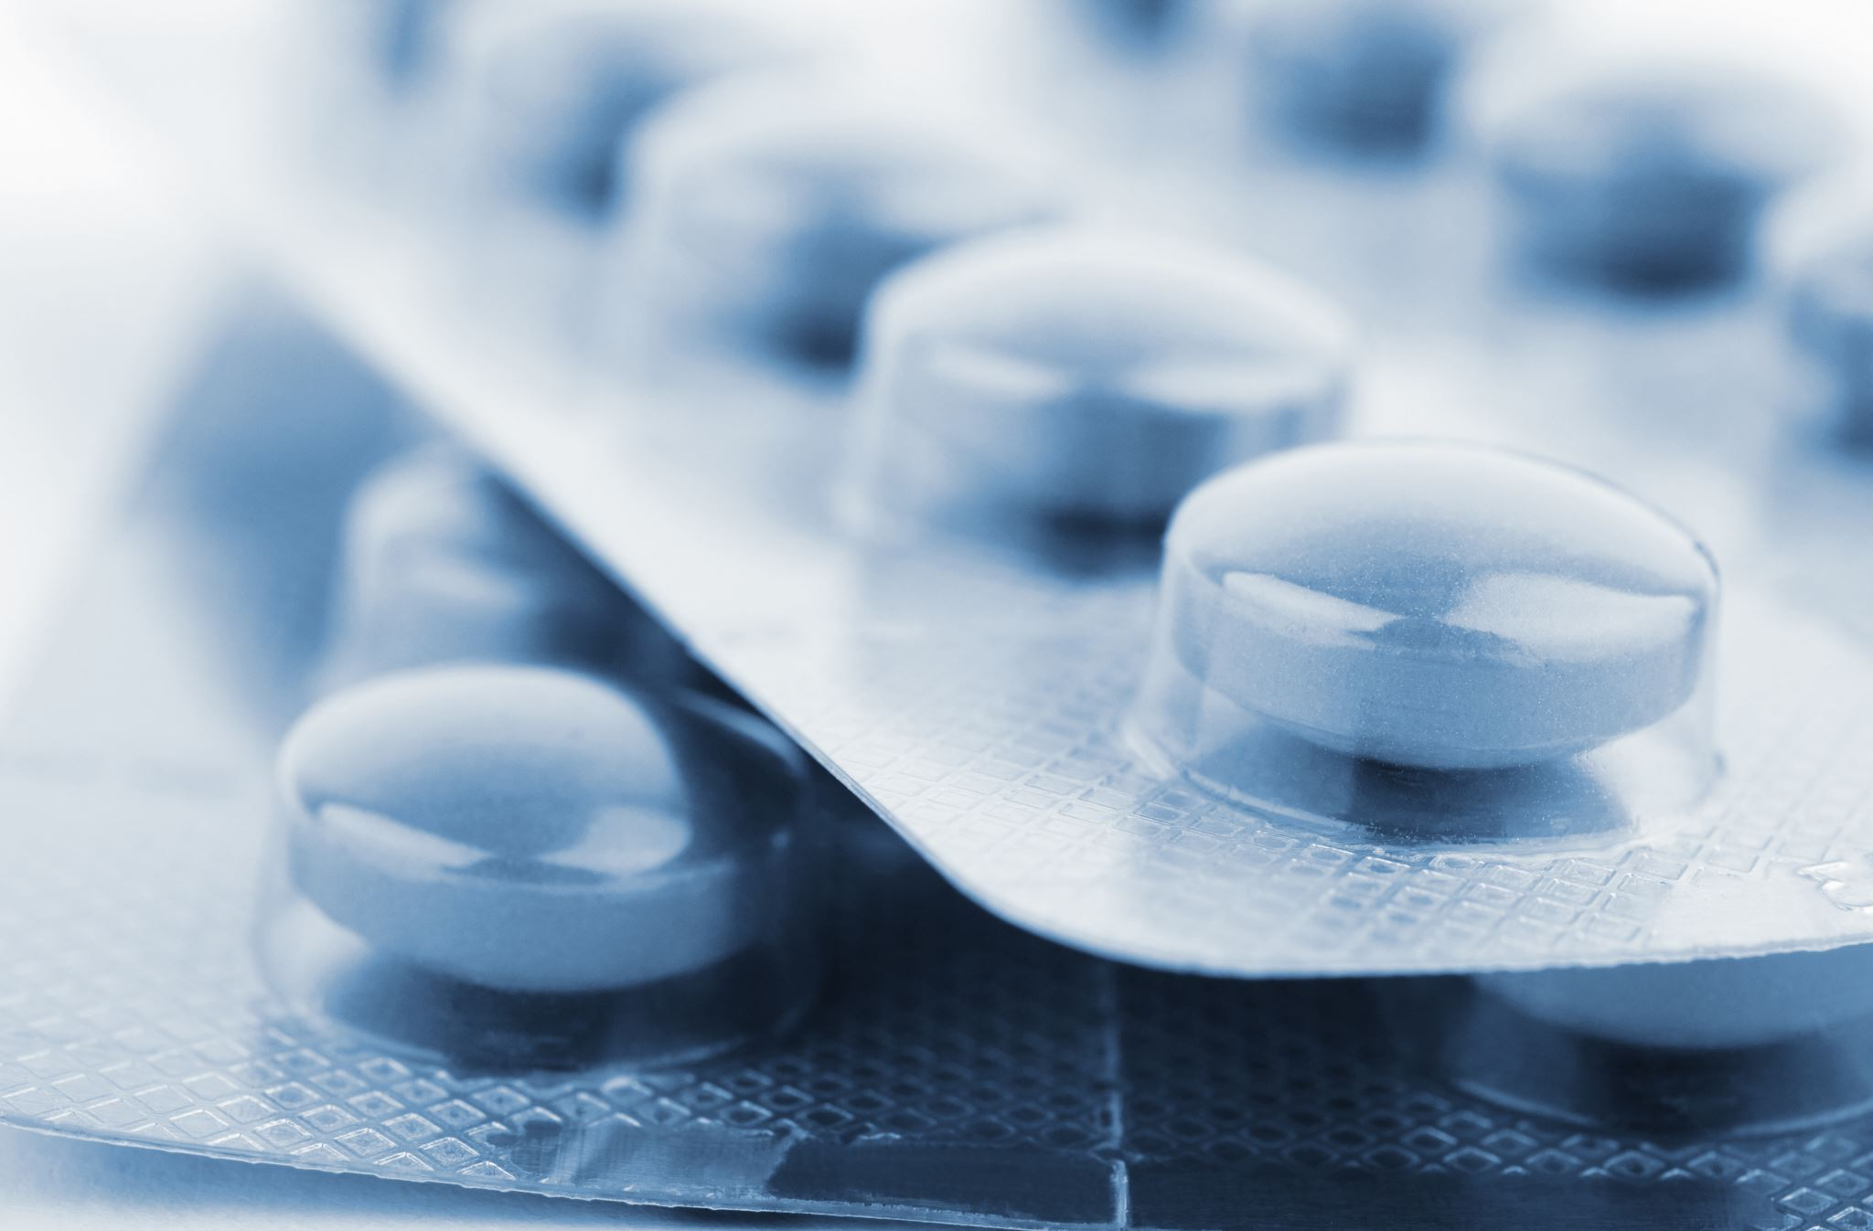
Definition: Addiction
Addiction is a chronic but treatable medical disease.
It involves brain function, genetics, environment, and life experiences.
Prevention and treatment approaches can be effective.
Success rates are similar to those of other chronic diseases.

Slide 10
Thank You

Slide 11
Resources
Asam’s-2019-definition-of-addiction-(1).pdf. American Addiction Centers. (n.d.). https://www.asam.org/docs/default-source/quality-science/asam’s-2019-definition-of-addiction-(1).pdf?sfvrsn=b8b64fc2_2
Dr. Volkow Explains the Basics of Drugs & Addiction National Institute on Drug Abuse. (n.d.). Dr. Volkow explains the basics of drugs & addiction [Video]. https://nida.nih.gov/videos/dr-volkow-explains-basics-drugs-addiction
How an Addicted Brain Works National Institute on Drug Abuse. (2018, June 7). How an addicted brain works [Video]. YouTube. https://www.youtube.com/watch?v=F-sfiQZqG24

