Slide 1



Biological Disease
Model of Addiction
KEATON PETERSON
STUDENT

Slide 2

Biopsychosocial ​Vs. ​Biomedical ​Models of​ Addiction ​​1
The biopsychosocial model explains addiction as being influenced by biological/genetic, psychological, and sociocultural factors.
The biomedical model views addiction as a chronic, relapsing brain disease caused by measurable biochemical or neurophysiological brain changes.
Psychiatrist George Engel argued in 1977 that the biomedical model should be expanded into a biopsychosocial approach to better explain illness.
Health and illness are also influenced by factors like stress, beliefs, and environment, since people can react differently even to the same biological conditions.

Slide 3
Biopsychosocial ​Vs. ​Biomedical ​Models of​ Addiction ​2
​
Addiction is often surrounded by stigma, even though it is a chronic medical disease that can involve relapse and recovery cycles.
Recovery is possible, and many people improve with treatment, support systems, and healthy lifestyle changes.
FDA-approved medications can be used as part of treatment to help manage symptoms and support recovery.
Experts like the American Society of Addiction Medicine emphasize that addiction should be treated like other medical conditions with proper care and prevention.

Slide 4
Biological Factors and the Development of Additive Behavior
Children of alcohol-dependent parents are at higher risk, with males about four times more likely and females about three times more likely to develop alcohol dependence.
Around 30.8% of people with alcohol dependence have at least one alcohol-dependent parent, showing a strong family connection.
Twin studies support a genetic influence, with higher similarity in identical twins (54.2%) than fraternal twins (31.5%).
Research suggests heritability of alcohol dependence ranges from about 40% to 90%, and affected individuals may show brain differences such as altered EEG patterns and learning or language differences.

Slide 5
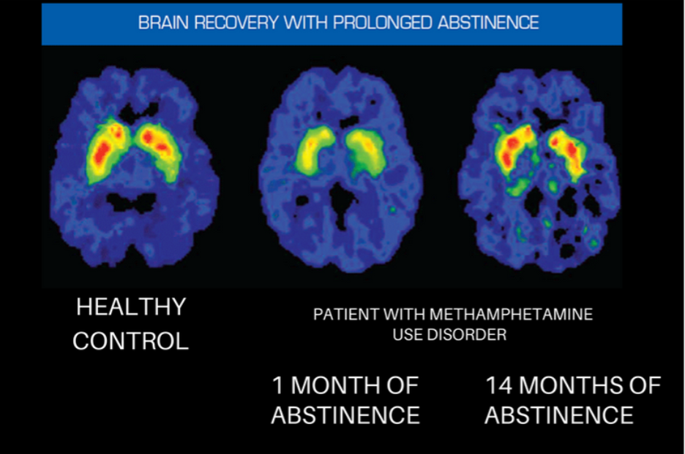

Slide 6
Genetics
Addiction does not have a single cause, but instead develops from a combination of biological, psychological, and environmental factors.
Family history increases risk, and children of alcohol-dependent parents are more likely to develop substance use problems.
Some genetic traits can be protective, such as variations that affect how alcohol is metabolized in the body.
Research shows that genes related to brain reward chemicals like dopamine, along with animal studies, provide strong evidence that genetics can influence addiction risk.

Slide 7
PSYCHOSOCIAL FACTORS AND THEDEVELOPMENTOF ADDICTIVE BEHAVIORS
Researchers identify multiple predictors of drug use, including personality traits, learning experiences, and cognitive processes.
Learning factors such as observing others or reinforcement can contribute to the development of substance use behavior.
Higher-order thinking processes like decision-making, planning, and judgment influence the initiation of drug use.
Addiction is often linked with mental health disorders such as depression and anxiety, and it is considered multifactorial, supporting the biopsychosocial model.

Slide 8
Risk Factors in children
Childhood abuse increases the risk of later alcohol and substance use disorders.
Externalizing behaviors in children, such as aggression and impulsivity, are linked to higher addiction risk.
Association with deviant peer groups during childhood/adolescence increases likelihood of substance abuse later.
Tolerance of deviance in adolescence predicts alcohol and drug abuse in adulthood.

Slide 9
Other Individual Differences Ethnicity and Culture
Substance use rates differ across ethnic groups due to factors like poverty, stress, discrimination, and neighborhood environment.
Cultural influences such as risk-taking, peer approval, and ethnic pride can shape substance use patterns and should be considered in prevention efforts.
Males generally have higher rates of substance use disorders, while females may develop dependence faster and be more affected by trauma and stress-related factors.
Legal policies, taxes, and community-level restrictions (such as alcohol bans) can significantly reduce substance use and related harm.

Slide 10
Social Influences on Substance Use
Parental monitoring, consistent discipline, and family support can reduce the risk of substance abuse and support recovery.
Becoming a parent, especially for women, can lower the risk of developing alcohol problems.
Peer influence is a strong predictor of substance use, especially among adolescents, and is shaped by stress, self-esteem, and social norms.
Substance use in adults is also influenced by partners, with heavy use in one spouse often linked to heavy use in the other.

Slide 11
Conceptual Models of Addictive Behavior
The moral model views addiction as a result of weak morals or poor willpower, but research provides little support for this idea.
The enlightenment model suggests recovery comes from surrendering the problem to a higher power and is linked to 12-step programs like Alcoholics Anonymous.
The medical model explains addiction as a chronic disease caused by genetic or biological factors, where individuals are not responsible for developing it.
The compensatory model argues that people are not responsible for developing addiction but are responsible for their recovery, using biological, psychological, and social approaches.

Slide 12

Classical and Operant Conditioning in Addictive Behaviors:
In classical conditioning, an unconditioned stimulus is paired with a conditioned stimulus, leading to a learned conditioned response such as craving.
Drug-related cues like people, places, or paraphernalia can become conditioned stimuli that trigger cravings and increase the risk of relapse.
In operant conditioning, substance use is reinforced because it produces pleasure (positive reinforcement) or relieves stress and negative emotions (negative reinforcement).
Classical and operant conditioning work together in addiction, where triggers lead to cravings and use, which is then reinforced through relief or reward.

Slide 13
Outcome Expectancies
Addiction is influenced not only by brain reward systems but also by the meanings and interpretations people assign to substance use.
Outcome expectancies are learned beliefs about the effects of alcohol or other drugs, such as relaxation, pleasure, or reduced tension.
These expectancies can develop through personal experience or by observing others, even without directly using the substance.
Drinking behavior can reinforce positive expectancies, strengthening the likelihood of continued substance use over time.

Slide 14

Treatment Approaches
Motivation strongly predicts whether individuals seek treatment, remain in treatment, and achieve recovery, and it can also support natural recovery without formal intervention.
The Transtheoretical Model explains behavior change as a process in which individuals move through stages of readiness based on their evaluation of the pros and cons of substance use and change.
Motivational interviewing is a therapeutic approach designed to increase internal motivation, especially in people who are initially resistant or uncertain about changing substance use behaviors.
Successful recovery is more likely when treatment strengthens motivation, self-efficacy, and coping skills together, allowing individuals to replace substance use with healthier behaviors and improve long-term outcomes.

Slide 15
Thank You

Slide 16
References
2024 National Survey on Drug Use and Health (NSDUH) Methodological Summary Substance Abuse and Mental Health Services Administration. (2024). 2024 NSDUH methodological summary and definitions. https://www.samhsa.gov/data/sites/default/files/reports/rpt56485/2024-nsduh-method-summary-defs.pdf
The Biopsychosocial Model of Addiction Miller, P. (2013). The biopsychosocial model of addiction. Masaryk University. https://is.muni.cz/el/1423/jaro2018/PSY109/um/68207459/Biopsychosocial_Model_of_Addiction_Miller_P__2013__Principles_of_Addiction.pdf

