Slide 1


Understanding Withdrawal Management
KEATON PETERSON
STUDENT

Slide 2
Withdrawal is the collection of physiological and psychological symptoms that appear when an individual reduces or discontinues use of a substance on which they have developed dependence. This occurs because the body and brain have neuroadaptation to the presence of the substance, so abrupt cessation results in a compensatory stress response.
What is Withdraw?

Slide 3
How the body reacts
Disruption in the brain's chemical balance can affect the nervous system, leading to symptoms such as anxiety, irritability, tremors, sweating, and insomnia.
The cardiovascular system may respond with increased heart rate, high blood pressure, and palpitations because of an overactive stress response.
Disruption in the normal regulation of movement and sensation can lead to pain, stiffness, and cramps in the muscles and joints.
The brain and emotional system may show mood swings, depression, cravings, and difficulty concentrating as neurotransmitters rebalance.

Slide 4

Why Medically Managed Withdrawal is Important
Medically managed withdrawal provides safety for severe withdrawal symptoms such as seizures, reduces relapse risk by stabilizing the body and managing cravings, and serves as a bridge to ongoing treatment including therapy and medication-assisted programs.

Slide 5
Teen Considerations
Adolescents’ Brains are still Developing, so Withdrawal can be more Psychologically Intense.
Withdrawal happens when the body reacts to stopping or reducing a substance, causing physical and emotional symptoms as the brain adjusts.
Teens need medically managed withdrawal because their brains and bodies are still developing, which can increase the severity of symptoms.
Supervised care helps keep teens safe by monitoring symptoms and reducing the risk of dangerous complications or relapse.
It also provides a structured path to continued care, including therapy, counseling, and recovery support program

Slide 6
Support is key
Family, school counselors, and peer support groups play an important role in helping teens stay on track during recovery.
Learning coping skills is essential for managing cravings and handling stress in healthy ways.
Medically managed care helps make the body safe and stable during withdrawal and early recovery.
Ongoing support prepares teens for long-term recovery and helps prevent future addiction or relapse.

Slide 7
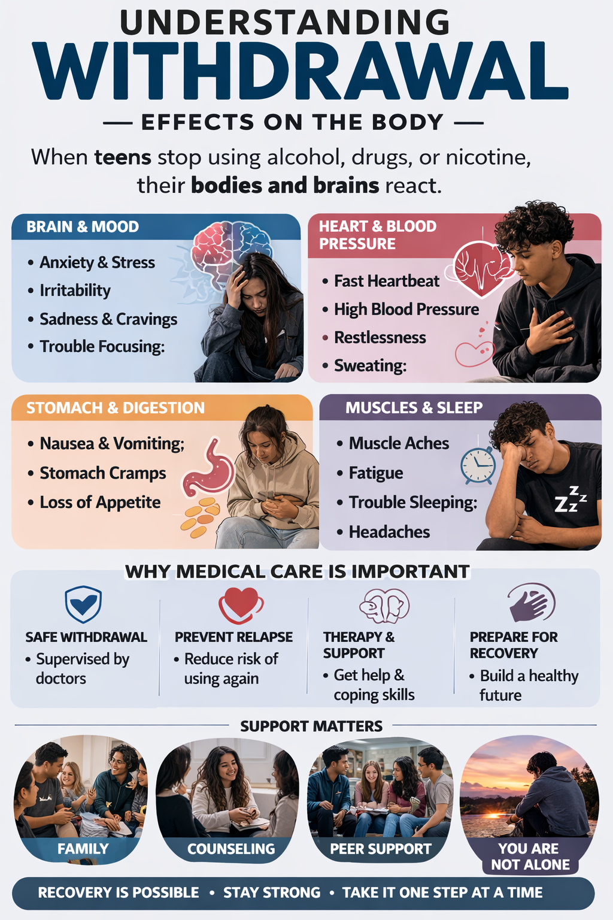

Slide 8
What Are The Side Effects of Drug Detox People undergoing drug detox may experience withdrawal symptoms that vary depending on the substance, including mood changes such as anxiety, depression, and agitation. They may also experience physical symptoms like flu-like illness, shaking, nausea, headaches, and strong cravings for the substance.

Slide 9
Outpatient detox services are provided at scheduled intervals in settings such as a physician’s office or home health care, where patients are monitored for several hours a day while continuing to live at home.
2. Clinically managed residential detoxification (“social detox”) offers 24/7 supervision in a residential setting with minimal medical oversight, focusing on peer support and emotional stabilization during withdrawal.
3. Medically monitored inpatient detoxification provides continuous 24/7 medical care in a hospital or inpatient facility to closely manage withdrawal symptoms and respond to complications.
4. Medically managed intensive inpatient detoxification is the highest level of care, offering constant acute medical supervision for individuals with severe or complex withdrawal and medical needs.
Ambulatory Detoxification ​

Slide 10
Quitting Drugs Cold Turkey
Quitting one or multiple drugs “cold turkey,” or all at once, can prove dangerous for certain substances.
Alcohol, when stopped abruptly after chronic, long-term use, can cause seizures, delirium, diarrhea, and sometimes death.
Moderate to severe withdrawal of opioids also often includes drug cravings. Experiencing these suddenly all at once often prompts a person to relapse and return to opioid use.
Therefore, it is a good idea to consult with a physician before quitting any drug cold-turkey. It may also be helpful to contact a drug detox center to decide whether a medically managed detox program is right for you

Slide 11
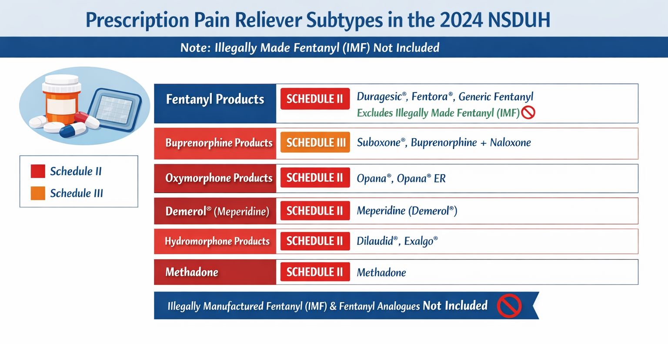

Slide 12
Q and A: For Parents

Slide 13
Q and A
Question:
How can someone become addicted to medications that are prescribed by doctors?
Some prescribed medications can influence the brain’s reward, pain, and anxiety systems, increasing the risk of addiction over time by altering neurotransmitters such as dopamine.
Certain medications, including opioids, benzodiazepines, and stimulants, are especially associated with addiction potential because they strongly affect brain chemistry and reinforcement pathways.
Continued use can lead to tolerance and physical dependence, meaning higher doses may be needed for the same effect and withdrawal symptoms may occur if the medication is reduced or stopped.
Psychological dependence and misuse can also develop when individuals rely on medications to cope with stress, pain, or emotions, and addiction is recognized as a medical condition that can occur even when prescriptions are followed.

Slide 14
Question:
WHY DO SOME PARENTS BELIEVE PRESCRIPTION DRUG MISUSE IS LESS SERIOUS THAN USING LEGGAL DRUG?
Because they are legally prescribed by doctors to treat medical conditions, some parents may believe that their child’s use of these medications is less dangerous than using illegal drugs like cocaine or heroin.
However, when prescription drugs are taken without following a doctor’s instructions, in higher doses, or for the purpose of getting high, it is considered misuse and can be very harmful.
Misusing prescription medications can lead to addiction, serious health problems, and even overdose, making them just as dangerous as illicit drugs.

Slide 15
Question: HOW CAN SOMEONE BECOME ADDICTED TO MEDICATIONS THAT ARE PRESCRIBED BY DOCTORS?
If medications are taken in ways other than how a doctor prescribed them, problems can develop. This may include taking higher doses.
using the medication more often or using it for reasons other than treating a medical condition, such as to feel relaxed or high. Over time.
the brain can become dependent on the drug, making it harder to stop using it, and this dependence can lead to addiction even if the medication originally came from a doctor.

Slide 16

Thank You

Slide 17
References
Continuity of Care After Medically Managed Withdrawal Substance Abuse and Mental Health Services Administration. (2024). Continuity of care after medically managed withdrawal from alcohol and/or drugs (CBE #3312) technical specifications and resource manual. https://www.samhsa.gov/sites/default/files/cbe-3312-technical-specifications-manual.pdf

